Slide 1
The Exponential Evolution of Technology: Computing
Ravi Mittal
ravi.mittal@iitgoa.ac.in
Indian Institute of Technology, Goa

Slide 2
In the class we will study
Evolution of computers
Moore’s law
Multicore processors
Impact of Moore’s law

Slide 3
Evolution of Computing

Slide 4
ENIAC (1946)
First electronic general-purpose computer
Construction started in secret at UPenn Moore School of Electrical Engineering during WWII to calculate firing tables for US Army, designed by Eckert and Mauchly
17,468 vacuum tubes
Weighed 30 tons, occupied 1800 sq ft, power 150kW
Twelve 10-decimal-digit accumulators
Had a conditional branch!
Programmed by plugboard and switches, time consuming!
Purely electronic instruction fetch and execution, so fast
10-digit x 10-digit multiply in 2.8ms (2000x faster than Mark-1)
As a result of speed, it was almost entirely I/O bound
As a result of large number of tubes, it was often broken (5 days was longest time between failures)

Slide 5

ENIAC
Changing the program could take days!
[Public Domain, US Army Photo]

Slide 6
Cambridge EDSAC (1949)
Maurice Wilkes came back from workshop in US and set about building a stored-program computer in Cambridge
EDSAC used mercury-delay line storage to hold up to 1024 words (512 initially) of 17 bits (+1 bit of padding in delay line)
Two’s-complement binary arithmetic
Accumulator ISA with self-modifying code for indexing
David Wheeler, who earned the world’s first computer science PhD, invented the subroutine (“Wheeler jump”) for this machine
Users built a large library of useful subroutines
UK’s first commercial computer, LEO-I (Lyons Electronic Office), was based on EDSAC, ran business software in 1951
Software for LEO was still running in the 1980s in emulation on ICL mainframes!
EDSAC-II (1958) was first machine with microprogrammed control unit

Slide 7
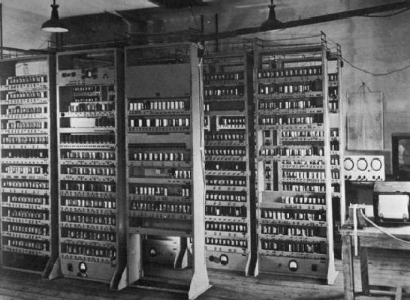
EDSAC
EDSAC, University of Cambridge, UK, 1949

Slide 8
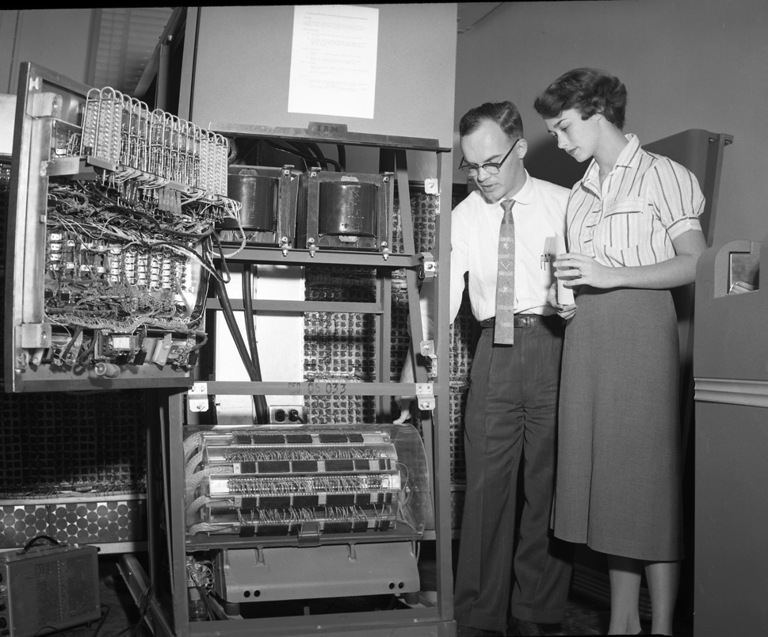
IBM 650 (1953)
The first mass-produced computer
Low-end system with drum-based storage and digit serial ALU
Almost 2,000 produced
[Cushing Memorial Library and Archives, Texas A&M,
Creative Commons Attribution 2.0 Generic ]

Slide 9
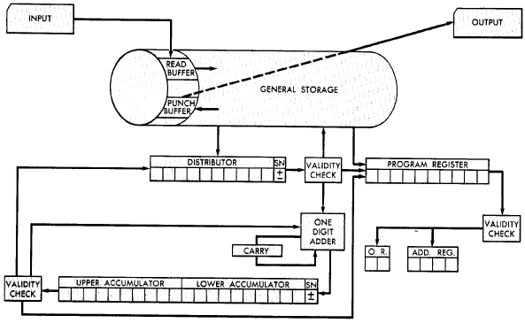
IBM 650 Architecture
Magnetic Drum (1,000 or 2,000
10-digit decimal words)
Active instruction (including next program counter)
Digit-serial ALU
20-digit accumulator
[From 650 Manual, © IBM]

Slide 10
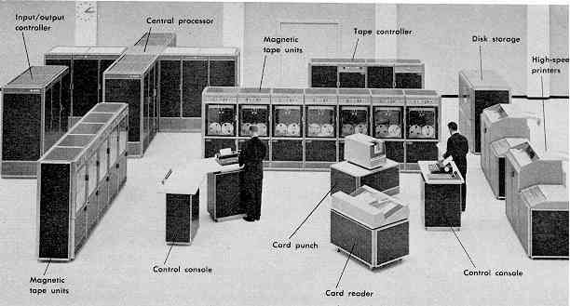
Computer Eras: Mainframe 1950s-60s
Processor (CPU)
I/O
“Big Iron”: IBM, UNIVAC, … build $1M computers for businesses ➔ COBOL, Fortran, timesharing OS
Ref: CS 61C, Prof Asonovic, Univ of California, Berkeley

Slide 11
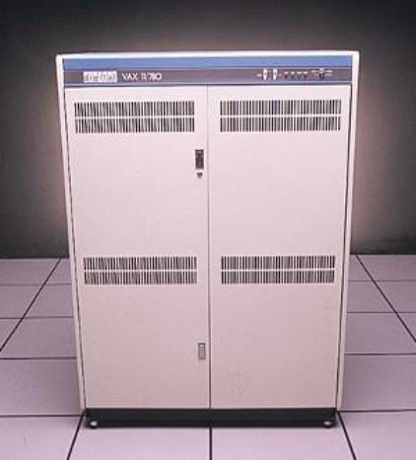
Minicomputer Eras: 1970s
Using integrated circuits, Digital, HP… build $10k computers for labs, universities ➔ C, UNIX OS
Ref: CS 61C, Prof Asonovic, Univ of California, Berkeley

Slide 12

PC Era: Mid 1980s - Mid 2000s
Using microprocessors, Apple, IBM, … build $1k computer for 1 person ➔ Basic, Java, Windows OS
Ref: CS 61C, Prof Asonovic, Univ of California, Berkeley

Slide 13

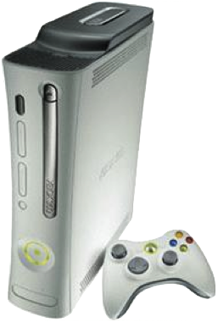
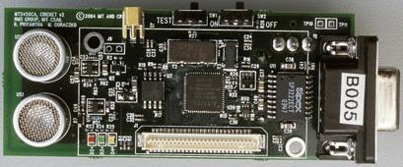
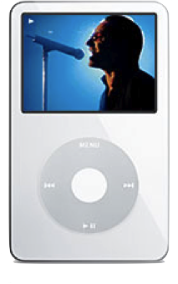
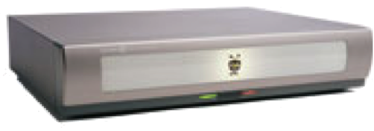
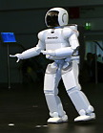
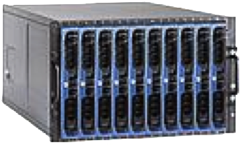
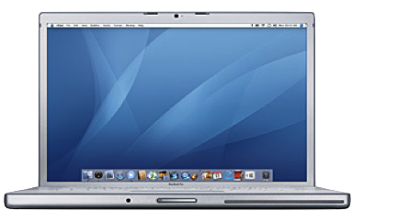
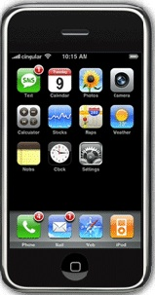
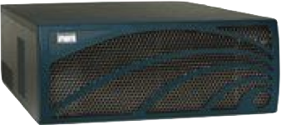

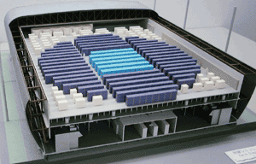
Computing Devices Now
Sensor Nets
Cameras
Games
Set-top boxes
Media Players
Laptops
Servers
Routers
Robots
Smart phones
Automobiles
Supercomputers

Slide 14
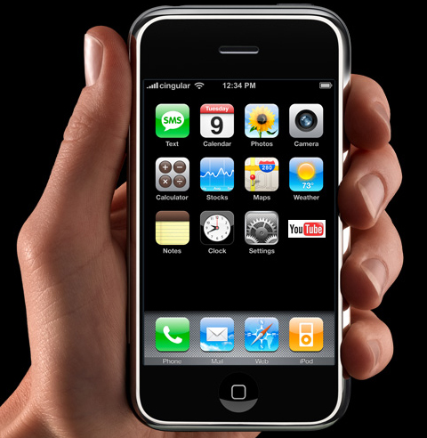
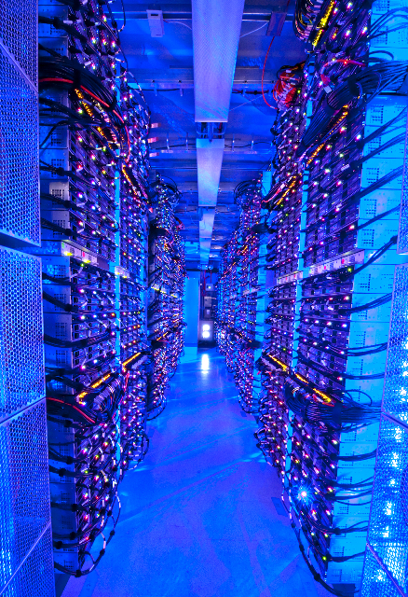
PostPC Era: Late 2000s - ??
Personal Mobile Devices (PMD): Relying on wireless networking, Apple, Nokia, … build $500 smartphone and tablet computers for individuals ➔ Objective C, Swift, Java, Android OS + iOS
Cloud Computing: Using Local Area Networks, Amazon, Google, … build $200M Warehouse Scale Computers with 100,000 servers for Internet Services for PMDs
Ref: CS 61C, Prof Asonovic, Univ of California, Berkeley

Slide 15
What has caused the exponential Evolution of Computing and Communication?

Slide 16
The World is flat now..
Sitting in Gotegaon in MP, you can access any document or artifact – just as anyone does in Bay Area in Silicon Valley can do…
What has made this possible ….
Affordable Computing
Affordable Communication
Computer Technology advanced very fast – almost two times computing power – every 1.5 years --> for the same computing power, cost reduces by half every two years..
Tremendous improvements in Chip Technology
Communication advances lagged behind for the first 30 years.. Now trying to catch up
Fiber Optics, 4G-5G, The Internet

Slide 17
Moore’s Law

Slide 18
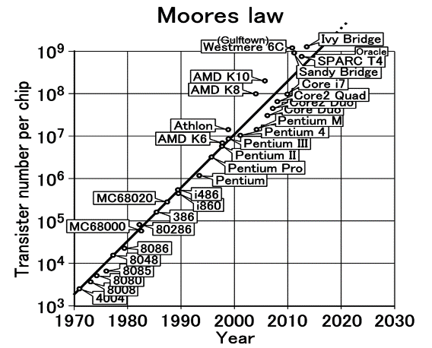
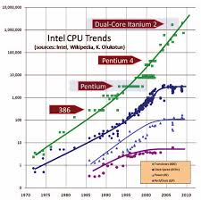
Moore’s Law
The number of transistors on a chip doubles about every 18-24 months
Gordon Moore, co-founder of Intel, 1965
True for 50+ years

Slide 19
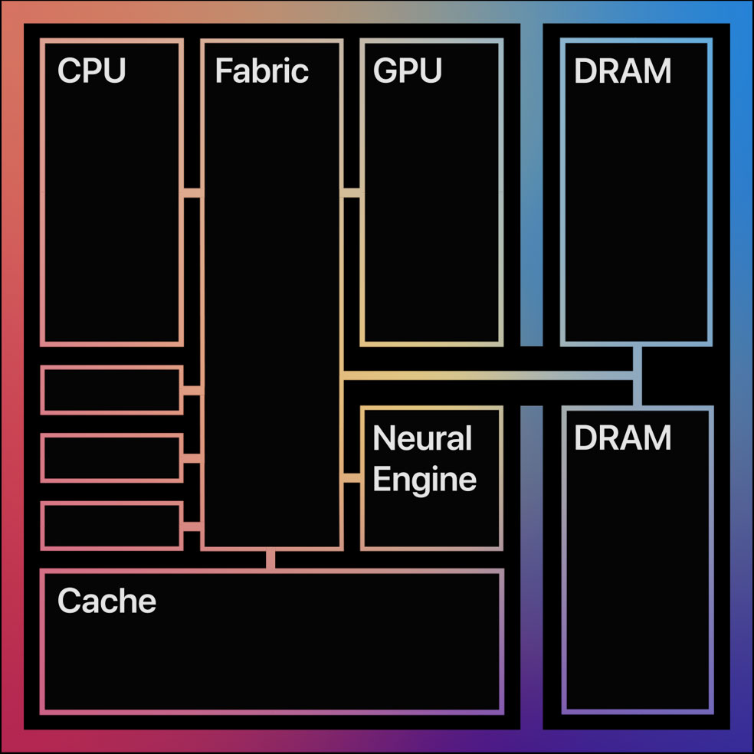
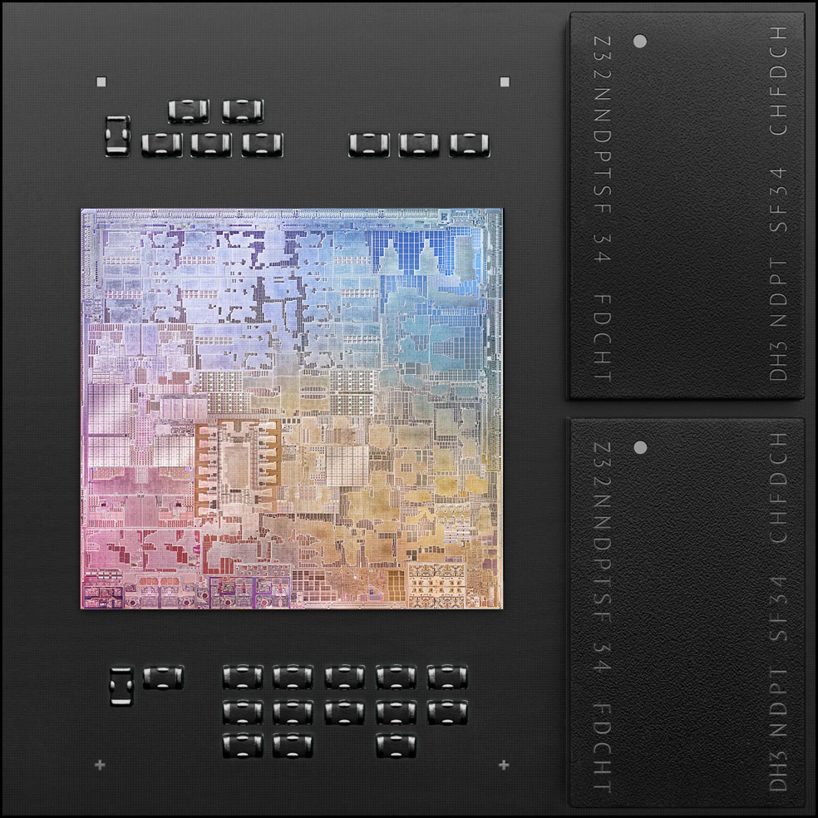
What makes Moore’s law possible?
Transistors are getting smaller in each generation
70% in each dimension compared to previous generation
Current transistor dimension: 5nm - 20nm
Recently released Apple’s M1 chip uses 5nm technology
16 Billion transistors

Slide 20
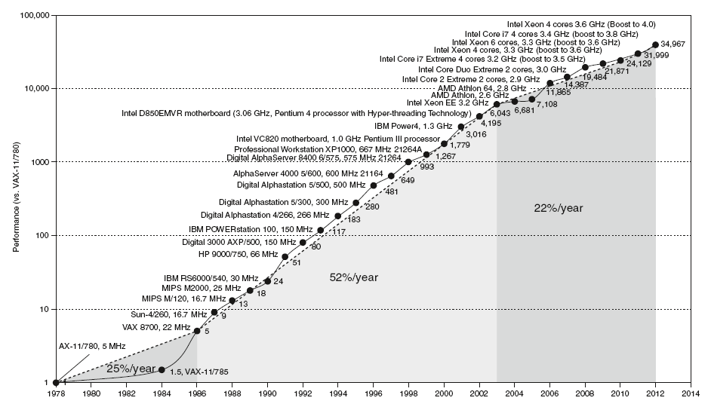
Uniprocessor Performance
Constrained by power, instruction-level parallelism, memory latency
Chart plots performance relative to the VAX 11/780

Slide 21
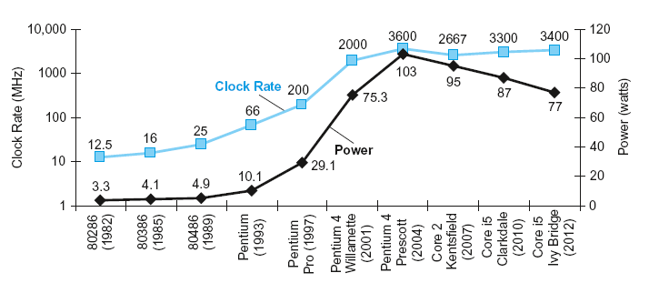
Power and Clock Rate - Trend
In CMOS IC technology
Chapter 1 — Computer Abstractions and Technology — Patterson and Hennessy

Slide 22
Faster Clocks, Power dissipation, Heat…
Note that clock rates are not increasing any more
Faster clocks – Faster execution of programs (in general)
Why can’t we continue to increase clock speed?
Power dissipation – yes. What else
Wire length – communication time limitation – within a clock cycle
Pipeline Depth – study later
Why is there limitation on electric power?
Heat and battery/power consumption

Slide 23
Power, Multicore
Most of last 50 years, Moore’s Law ruled
Technology scaling allowed continual performance/energy improvements without changing software model
Increase in the number of transistors (as per Moore’s law) will see increase in number of cores – in proportion to the number of processors
Haswell Xeon CPUs already offer up to 18 cores
Knights Landing Xeon Phis will be equipped with 72 cores
This will require massively parallel algorithms
For practical reasons of cooling, all mainstream computing hardware today is limited to about 250 to 300 Watts

Slide 24
Towards multicore processor

Slide 25
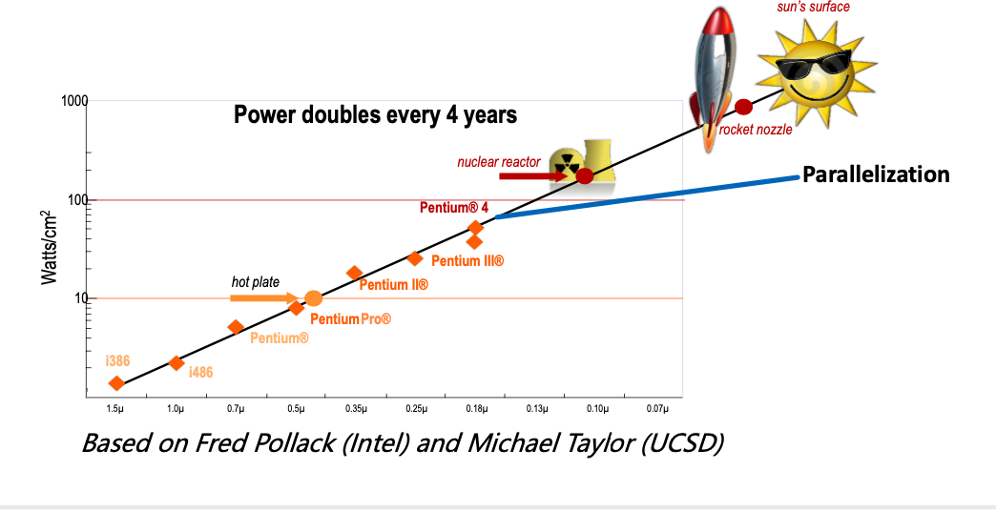
One Solution - Parallelization
No “free lunch” for software developers, must consider:
Parallel systems

Slide 26
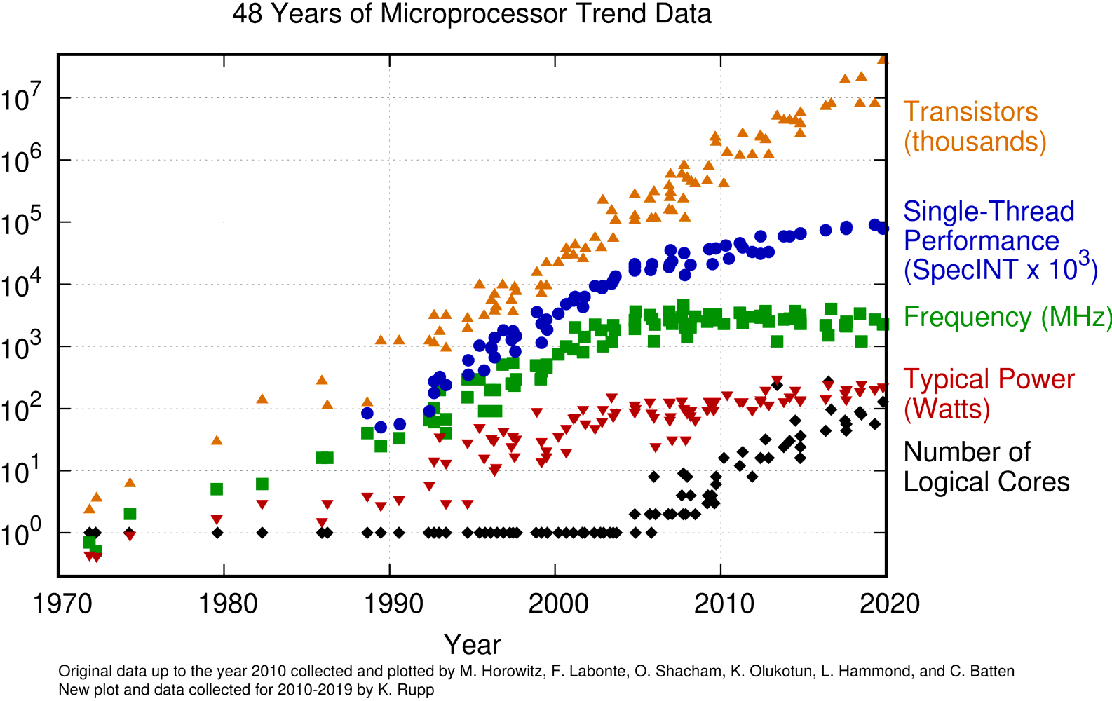
Moore’s Law → Multiple cores
https://www.karlrupp.net/2015/06/40-years-of-microprocessor-trend-data/

Slide 27
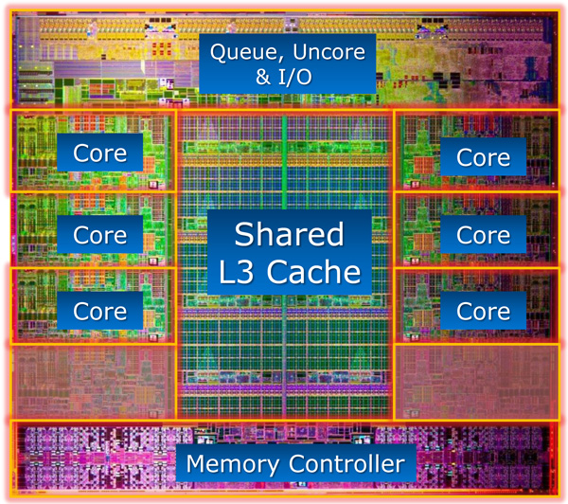
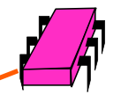
An example of Modern Chip Microprocessor
All on
The same
chip
Sandy Bridge E die
https://www.anandtech.com/show/5091/intel-core-i7-3960x-sandy-bridge-e-review-keeping-the-high-end-alive

Slide 28
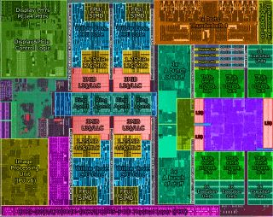
Intel’s Tiger Lake (Sept 2020)

Slide 29
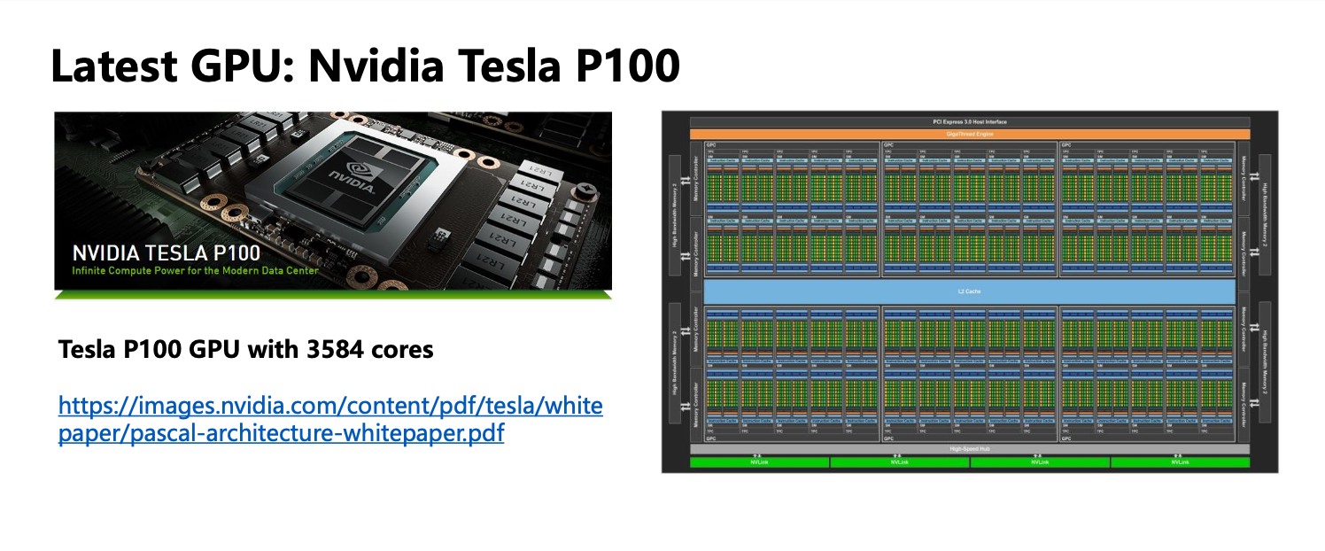
GPU

Slide 30
Impact of Moore’s Law

Slide 31
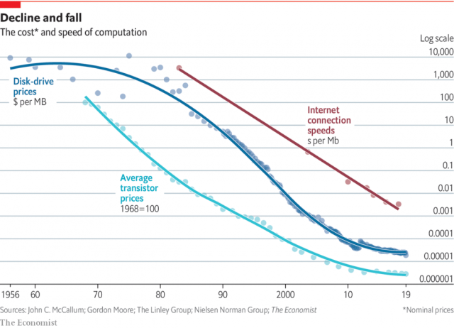
Exponential reduction in cost

Slide 32
Reduction in Cost
Computing Cost:
The price of computation today is roughly one hundred-millionth what it was in the 1970s, when the first microprocessors became commercially available
Data Storage Cost:
1956: 1 Megabyte: $9,200 ($85,000 in today’s prices)
2019: 1 Megabyte: $0.00002
Operational Cost:
A significant reduction in operational cost due to more energy efficient designs
Data communication cost:
Exponential reduction in the cost of per bit transmission in the last few decades

Slide 33
Moore’s law and Digital Transformation
Now, almost every person in the world has a powerful computing and communication device → Mobile
Computer that allows phone calls, shoot video, make transactions, make video calls, play music, read newspapers, exchange emails and instant messages, Internet device
It’s really big computer – bigger than Supercomputer of 80’s
Over 15 million lines of code

Slide 34
And Many more…
Cars → Computers that can be driven
Airplane → Computer that fly - carry people and goods
Refrigerator → Computer that cools things down
Microwave Oven → computer that heats up
House Lock → Computer that locks doors
Camera → Computer with lens
ATM → Computer with money inside
Modern light bulb → Computer that gives bright light
TV → Computer that shows video program
Washing machine → Computer that washes clothes
Voting Machines → Computer that enables voting

Slide 35
How can a business take advantage of DT?
Computers attached to everything
Better Management
Enhanced Flexibility
Enhanced Functionality
Data collection
Think - how a business can transform taking advantage of enhanced
Scope
Scale
Speed
Computers are being used in every domain of a business
Sales and Marketing, CRM,
Internal Operations, HR, Finance,
Manufacturing, Supply Chain, ERP, Development

Slide 36
Backup

